Slide 1
Smart Event
How to organize an event?

Slide 2
what is the idea ?
If there are an organization or technical team ,or any event organizer and need to set priorities for every step would be done to organize an event .
Our system will produce a service to handle ,organize and present all of these steps and will provide a communication between every volunteer in the organizing team.
The system will service an outside support services with payment , more clearly the system will make a connection between the service provider(Photographers , Hall owners , graphic designers , social media providers) and the service User ( Event organizer ,Team organizer,....etc).
Smat Event

Slide 3
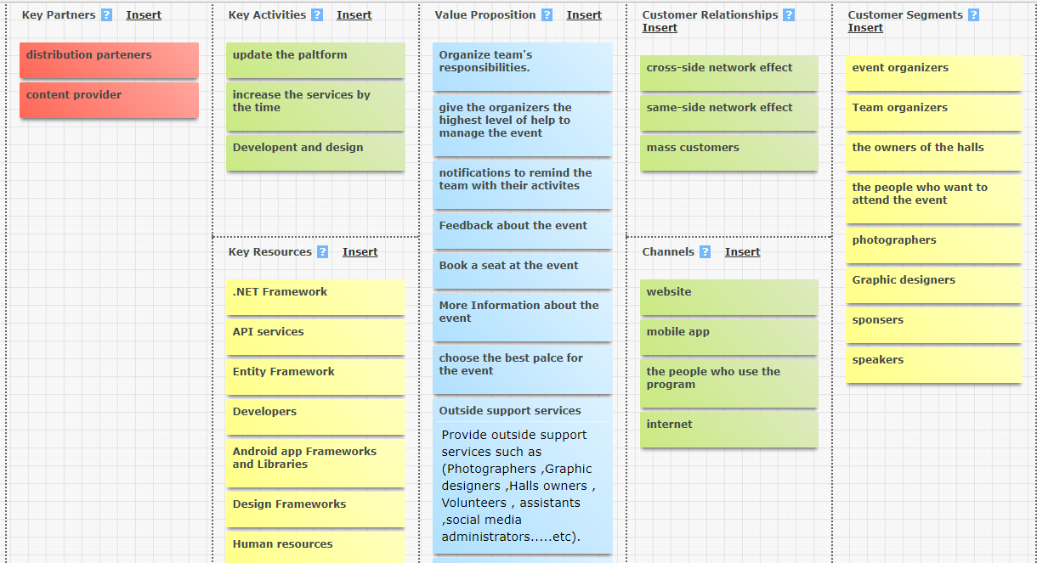
Business canvas model
Smat Event

Slide 4
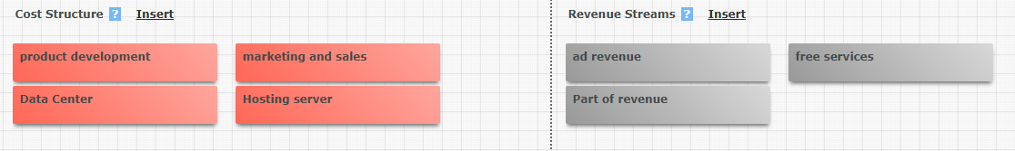
Smat Event

Slide 5
Requirements
what is the stackholders?
Event organizers.
Team organizers.
Sponsors.
Hall owners.
Graphic designers.
Photographers.
Speakers.
Smat Event

Slide 6
Requirements
what is the plateform?
Website
Mobile App
Smat Event

Slide 7
Functional Requirements
1
Event Organizers or (Team Organizers)
1-Register as an organizer
2-Contact with the other volunteers
3- Add the members of the team with there abilities
4- give tasks to the members.
5- Search for the most benefit places
6- Search for photographers.
7- Make reminder to remember every thing
in the event.
8- Inform the team members with renewals
in the event
Smat Event

Slide 8
Functional Requirements
1
Event Organizers or (Team Organizers)
9-Communicate with team members if they
are late
10-Communicate with the hall manager if any mistake happen
11-Be connected with the sponsor in case any needs
12-the system will produce an interface for determining all volunteers and their fields
Smat Event

Slide 9
Functional Requirements
2
Sponsers
1-Register
2-Know every thing about the event
3-Know every thing about the members of the team
4-Send money to the team
5-Connect to the team leader
6-Specify what he want to be able to sponsor the event
Smat Event

Slide 10
Functional Requirements
3
Hall Owners
1-Register as a Hall owners.
2-Put the description of the service
3-The system will publish his description of the hall.
4-they can post thier photos for the hall.
5-They can contract with the administrator of the organizers.
6-The system will put the payment of the account of the system and after the completion of the event the price will be sent to the hall owner account
Smat Event

Slide 11
Functional Requirements
4
Graphic Designer
1-Register as a Graphic Designer.
2-Make logo for the event.
3-Make videos to describe the event.
4-can post thier photos from the event
6-The system will put the payment of the account of the system and after the completion of the event the price will be sent to the Graphic Designer account
Smat Event

Slide 12
Functional Requirements
5
Photographers
1-Register.
2-set his portfolio.
3-communicate with organizers.
4-get notification of resent updates.
5-know time and place of event.
6-set his salary.
7-marketing.
Smat Event

Slide 13
Functional Requirements
6
The people who want to attend the event
1-Register and set his interests
2-know about the nearest event and its details
3-provide him with suggested event according to his interesting
4-give feedback about any event
5-connected with the team leader
6-enable him to book tickets of any event he want .
7-Receives notification about the event time.
Smat Event

Slide 14
Functional Requirements
7
Speakers
1-Register.
2-set his portfolio.
3-know about event details.
4-Recieves notification about his session time and place.
5-provide connection between him,team leader and attendants.
6-If there is any changes,a will notify him.
7-provide him with audience profile of the organizations or teams
Smat Event

Slide 15
Thank you
Smat Event

